Slide 1


Kakuma Food Distribution Analysis
Name: Akau Bior Course: Data Analytics Date: July 17, 2025 Project: Capstone Presentation
Disclaimer: All data presented in this analysis is fictional and for academic purposes only.

Slide 2

Introduction to the Challenge
Kakuma Refugee Camp hosts thousands of displaced individuals facing daily challenges.
Consistent and fair food distribution is critical for welfare and survival.
The camp frequently experiences issues of ration insufficiency.
Food rations are distributed monthly, impacting household stability.
This project analyzes food distribution trends using a simulated dataset to identify key areas for improvement.

Slide 3
Project Objectives: Enhancing Distribution
1
2
Analyze Distribution Trends
Evaluate Household Allocations
Assess current food distribution patterns across various zones and time periods within Kakuma.
Identify any variations or irregularities in food allocation based on household size or type.
3
4
Segment Beneficiaries
Generate Actionable Insights
Classify beneficiaries by zone and household size to gain targeted insights into their needs.
Provide data-driven recommendations to improve the fairness, consistency, and overall efficiency of food distribution.

Slide 4
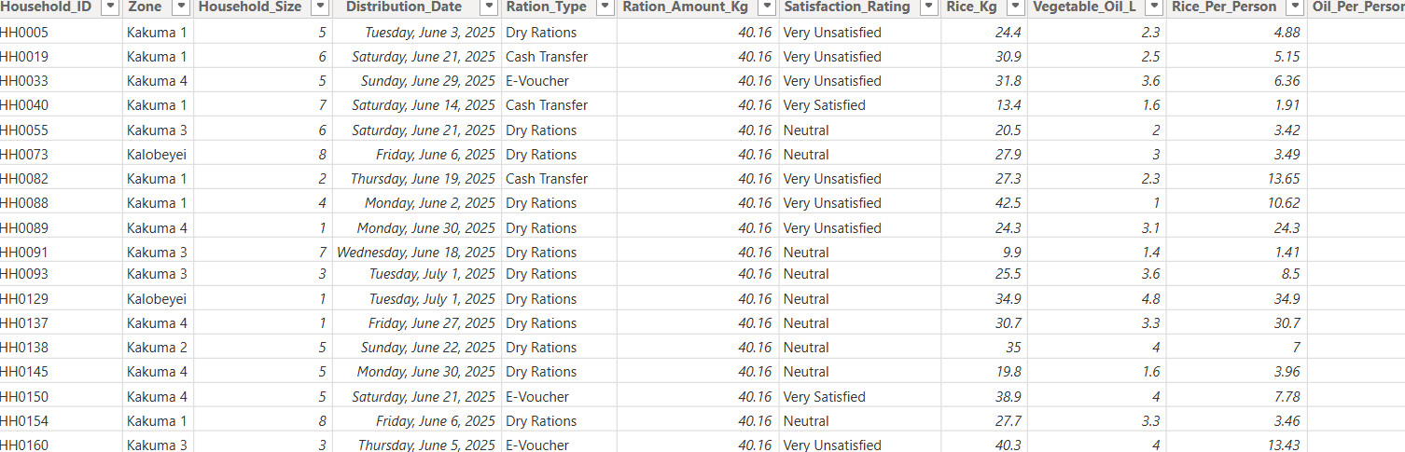
Dataset Overview: A Simulated Reality
The analysis is based on a simulated dataset, designed to mirror potential real-world distribution scenarios.
Nature: Fictional and created purely for academic analysis.
Dimensions: Comprises 16 distinct columns and 1000 detailed rows.
This synthetic data allows for a robust exploration of food distribution challenges without compromising real beneficiary privacy.

Slide 5
Methodology: Data Preparation and Enhancement
Data Transformation
Missing Value Imputation
Initial Data Cleaning
Engineered new features for deeper analysis:
Identified and addressed 100 missing values across various columns.
Applied appropriate methods:
Distribution Date: Backward fill (bfill) and forward fill (ffill).
Calculated per-person ration metrics.
Ration Amount: Median imputation to maintain data integrity.
Aggregated monthly and quarterly totals.

Slide 6
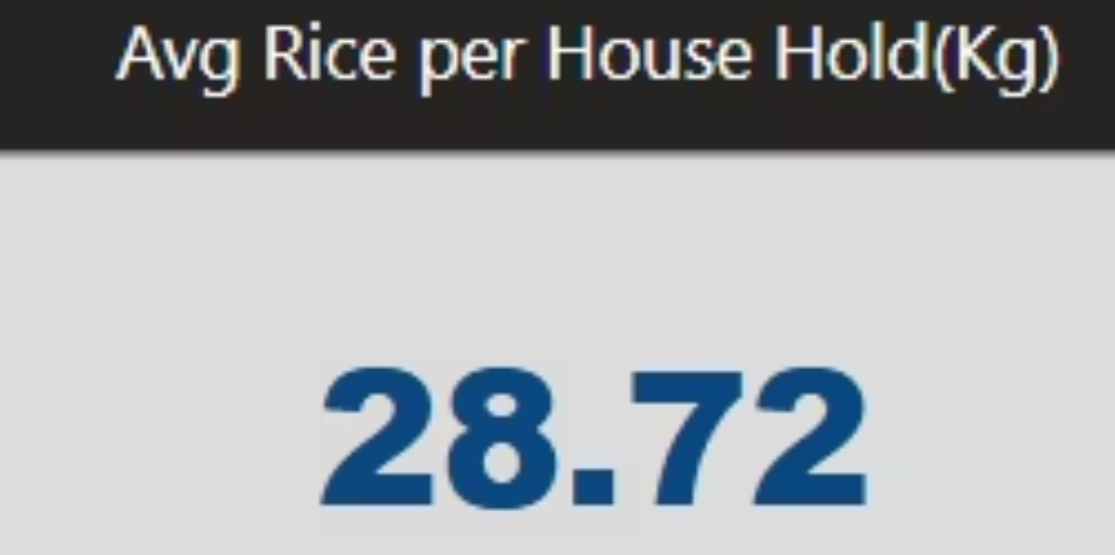
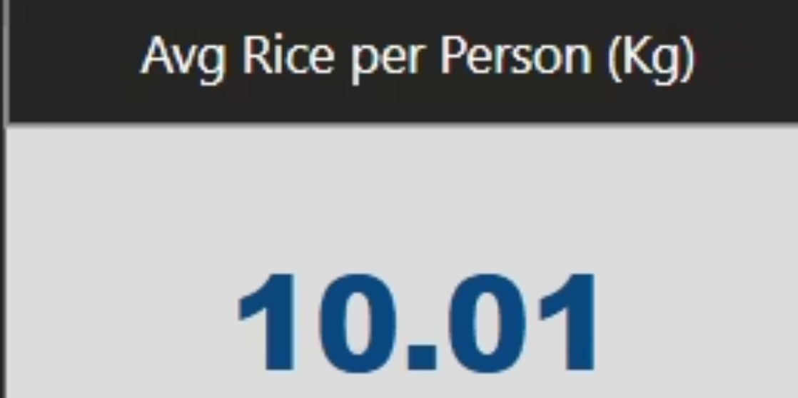
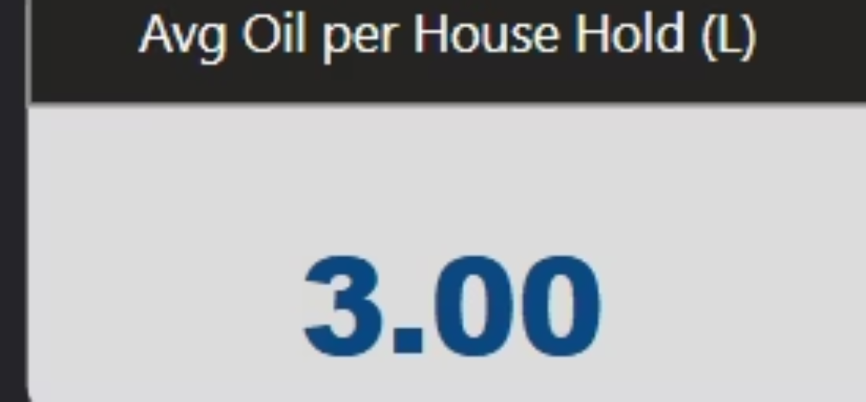
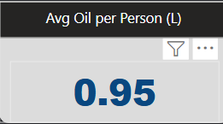
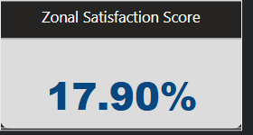
Key Performance Indicators (KPIs)
To effectively measure and assess the food distribution system, several Key Performance Indicators were defined and calculated. These KPIs provide a quantifiable basis for evaluating efficiency and fairness.

Slide 7
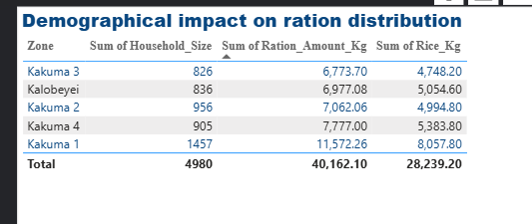

Distribution vs. Household Size
Analyzing the correlation between food distribution and household size is crucial for ensuring equitable allocation.
Insight: The analysis reveals that larger households consistently receive more food. While this might seem intuitive, it highlights the need for a deeper dive into per-person allocation to ensure equitable distribution regardless of household size. A standardized per-person ration is critical.

Slide 8
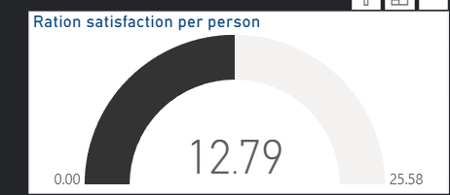

Beneficiary Satisfaction Score
Understanding beneficiary satisfaction is vital for assessing the effectiveness and human impact of the food distribution program.
Key Finding: On average, each individual in Kakuma is merely 12.8% satisfied with the current ration. This low satisfaction stems from the meager quantity and limited variety of food items supplied. There is significant room for improvement from humanitarian organizations like the UN to enhance the quality and quantity of provisions.

Slide 9
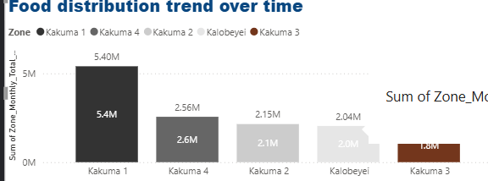

Monthly Food Distribution by Zone
Geographical analysis of food distribution helps identify potential disparities or efficiencies across different zones within Kakuma Refugee Camp.
Insight: Kakuma Zone 1 and Zone 4 receive significantly more food rations. This is directly attributable to their higher population densities. While proportionate to population, it's crucial to ensure the logistical efficiency and consistency of these larger distributions.

Slide 10
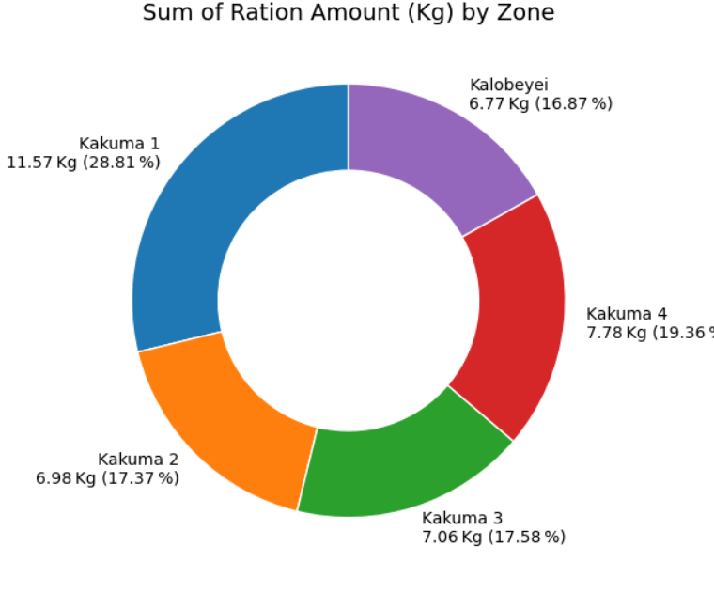
Food volume Analysis
Understanding the amount of food distributed across zones provides insights into the fairness and transparency in food ratio allocation in the camp.
Consistent with the overall distribution patterns, Kakuma Zones 1 and 4 receive a larger volume of various food types due to their substantial populations. This reinforces the need for scalable and efficient distribution mechanisms that can adapt to varying population sizes across the camp.

Slide 11
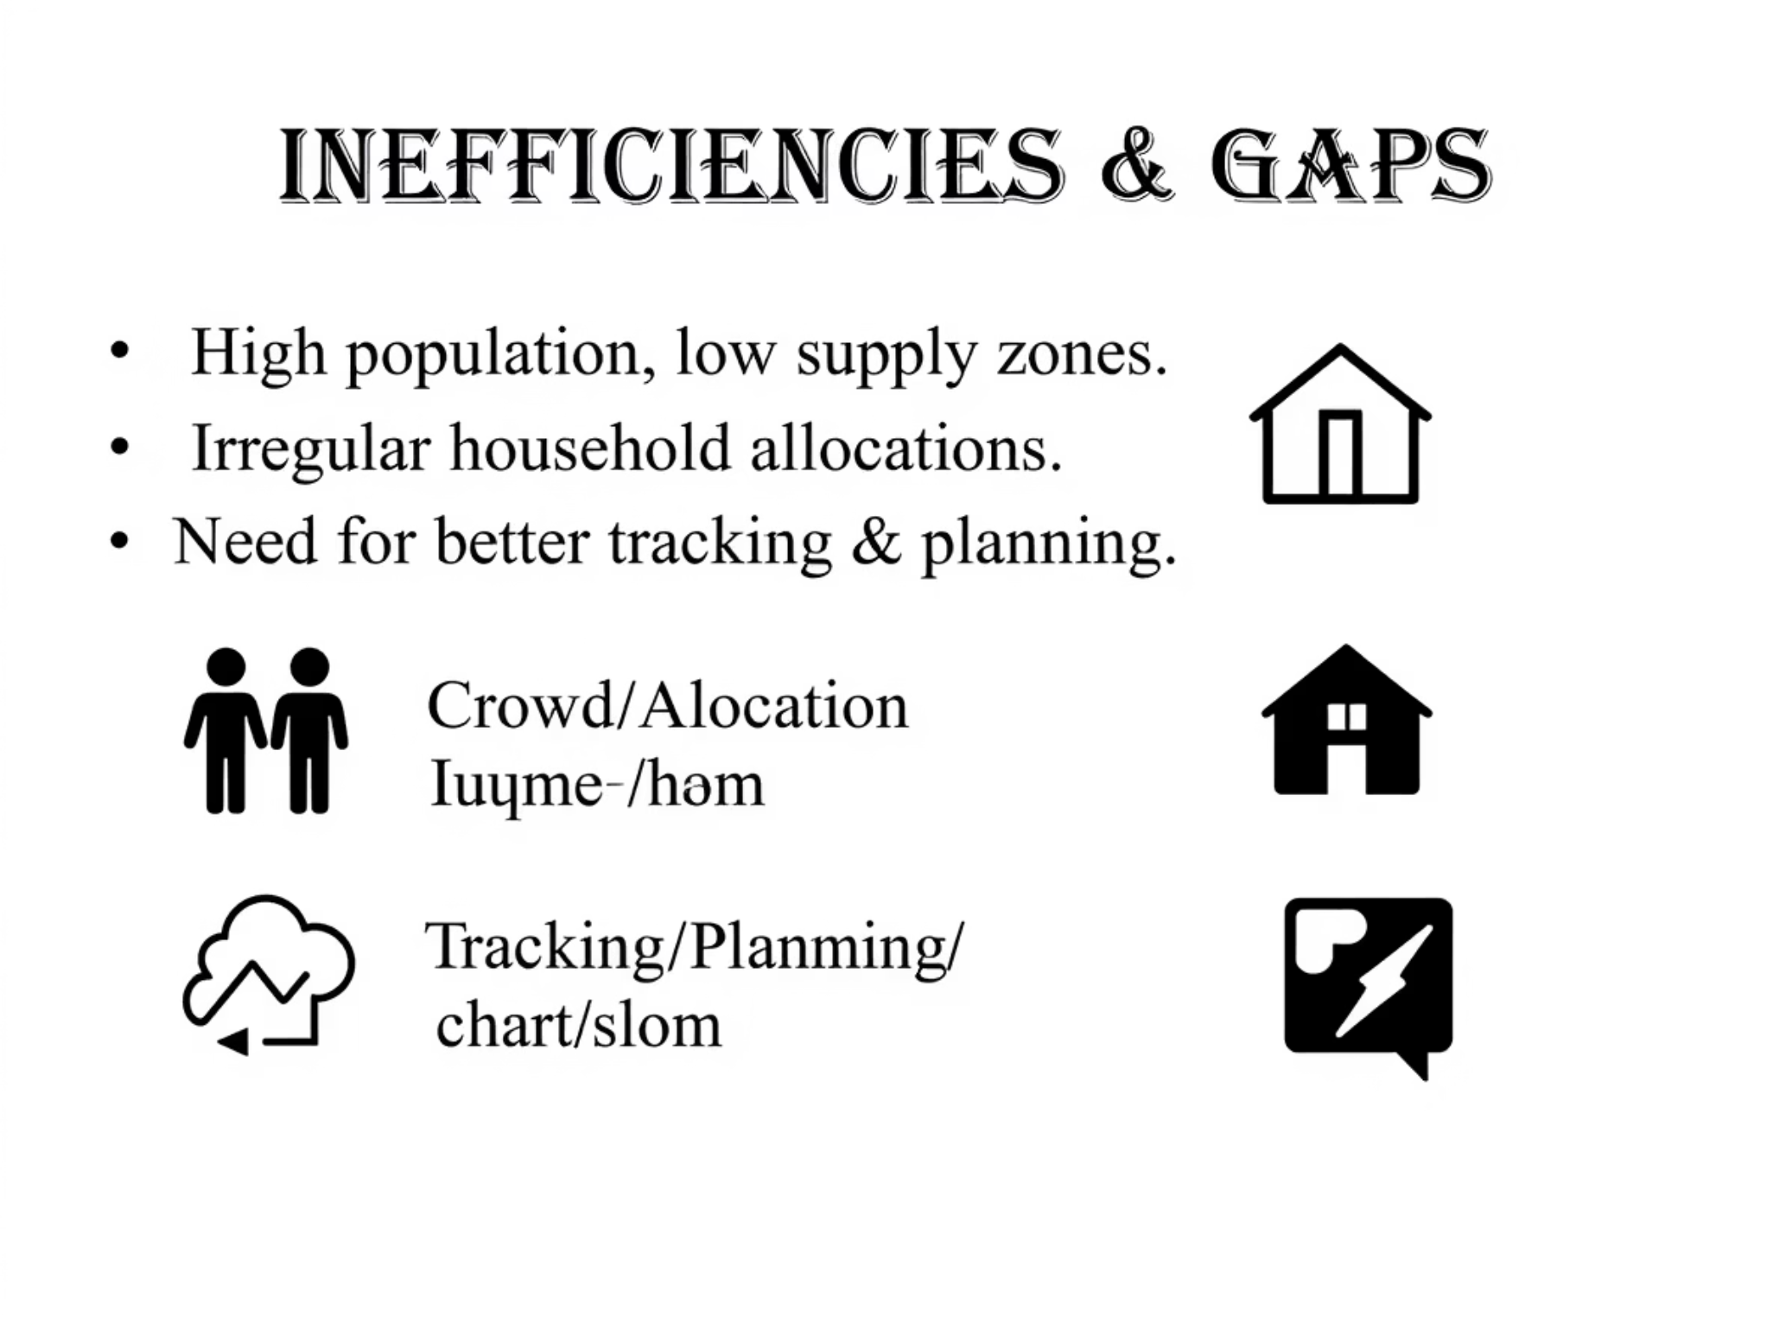

Slide 12
